Slide 1

Customer Shopping Behavior Analysis
Uncovering insights from 3,900 transactional purchases to guide strategic business decisions.

Slide 2

Project Scope: Data & Objectives
Key Features Analyzed
Dataset Summary
Customer Demographics (Age, Gender, Location)
3.9K
18
Purchase Details (Category, Amount, Season, Color)
Shopping Behavior (Discount, Previous Purchases, Review)
Rows
Columns
Subscription Status
Total Purchases
Data Points
Missing Data: 37 values in Review Rating were imputed using the median.
$59.76
Avg. Spend
Purchase Amount

Slide 3
Exploratory Data Analysis (EDA) in Python
Preparing and cleaning the dataset for robust analysis.
Data Loading & Exploration
Data Cleaning
Imported data using pandas and checked structure/summary statistics.
Imputed missing Review Ratings (median per category) and standardized column names to snake case.
Feature Engineering
Database Integration
Created age_group and purchase_frequency_days columns.
Loaded cleaned DataFrame into PostgreSQL for SQL-based business analysis.

Slide 4
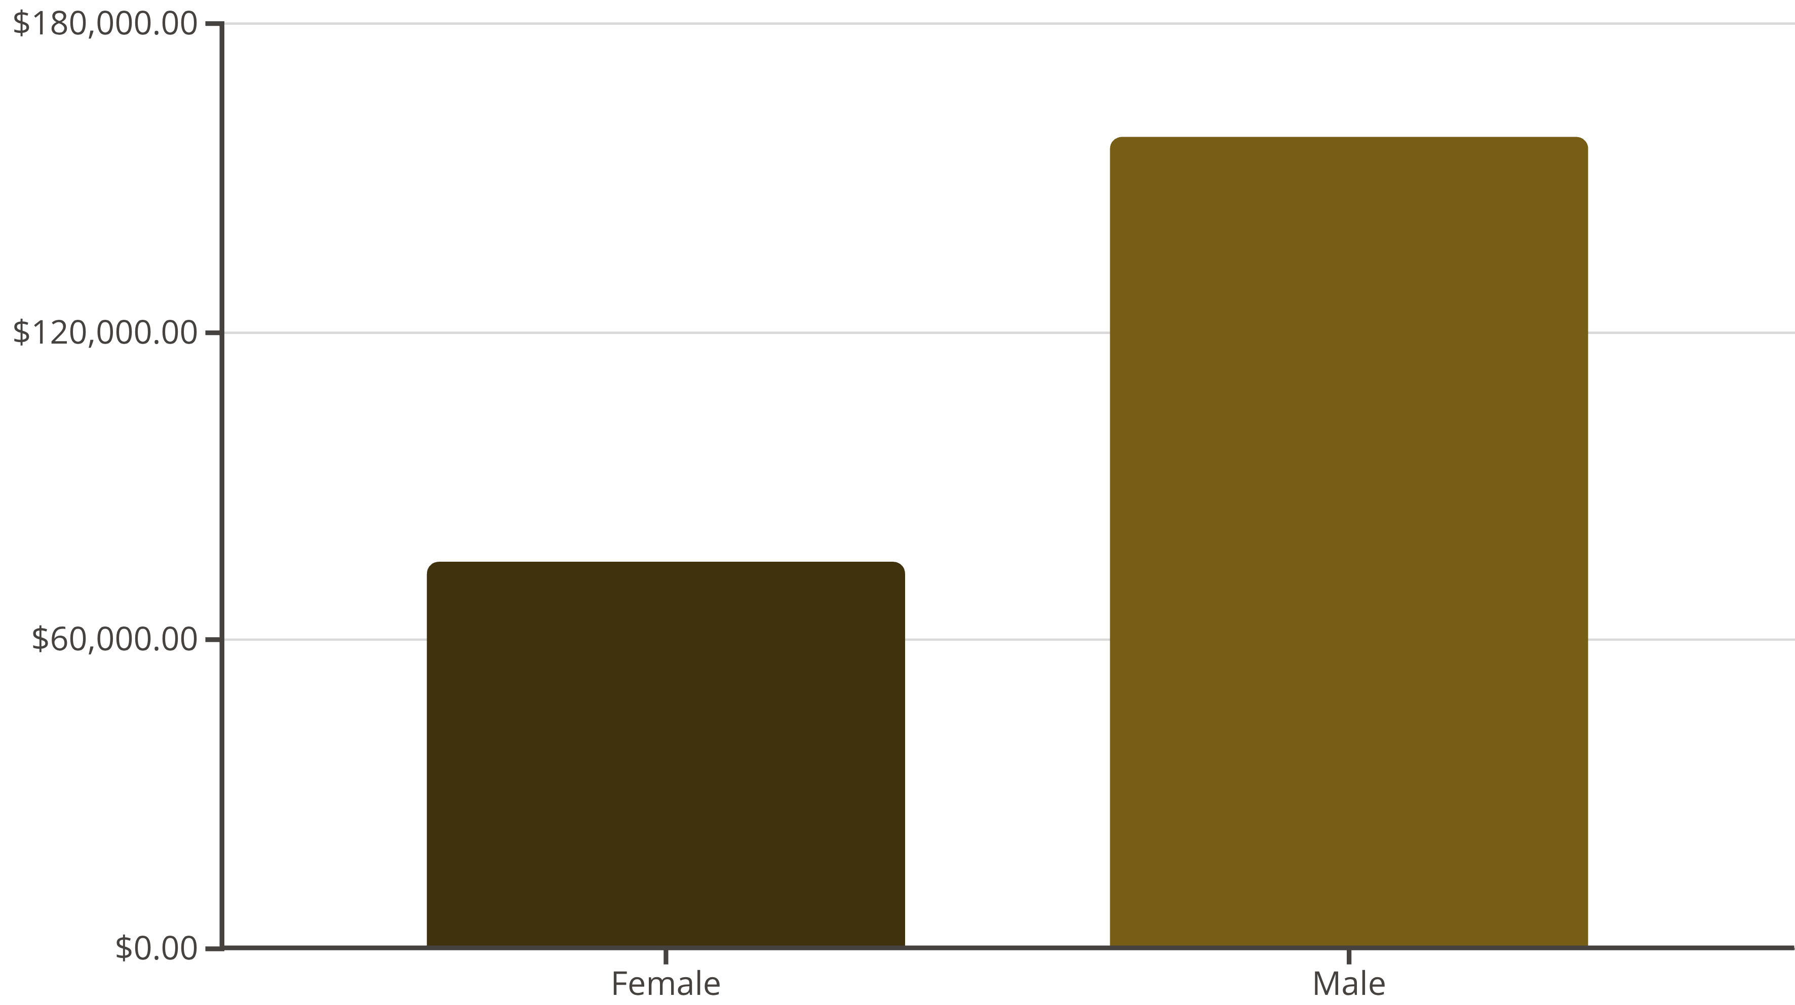
Revenue Breakdown by Gender
Male customers generate significantly higher total revenue.

Slide 5

Product Performance and Customer Segmentation
Top 5 Products by Rating
Top 3 Products per Category
Gloves (3.86)
Accessories
Jewelry, Sunglasses, Belt
Sandals (3.84)
Boots (3.82)
Clothing
Blouse, Pants, Shirt
Hat (3.80)
Footwear
Sandals, Shoes, Sneakers
Skirt (3.78)
Customer Segments
Outerwear
Jacket, Coat
Loyal: 3,116 Customers
Returning: 701 Customers
New: 83 Customers

Slide 6

Shipping and Discount Insights
Shipping Type
Discount Dependency
High-Spending Discount Users
Express shipping users have a higher average spend ($60.48) than Standard ($58.46).
Products like Hat (50%) and Sneakers (49.66%) show the highest percentage of discounted purchases.
839 customers used discounts but still spent above the average purchase amount.
Need to balance sales boost from discounts with margin control.

Slide 7

Subscription Impact and Age Group Revenue
Subscribers vs. Non-Subscribers
Revenue by Age Group
Status
Avg. Spend
Total Revenue
Young Adult: $62,143
Middle-aged: $59,197
Yes (1,053)
$59.49
$62,645
Adult: $55,978
No (2,847)
$59.87
$170,436
Senior: $55,763
Non-subscribers have slightly higher average spend, but subscribers are more likely to be repeat buyers (>5 purchases).

Slide 8
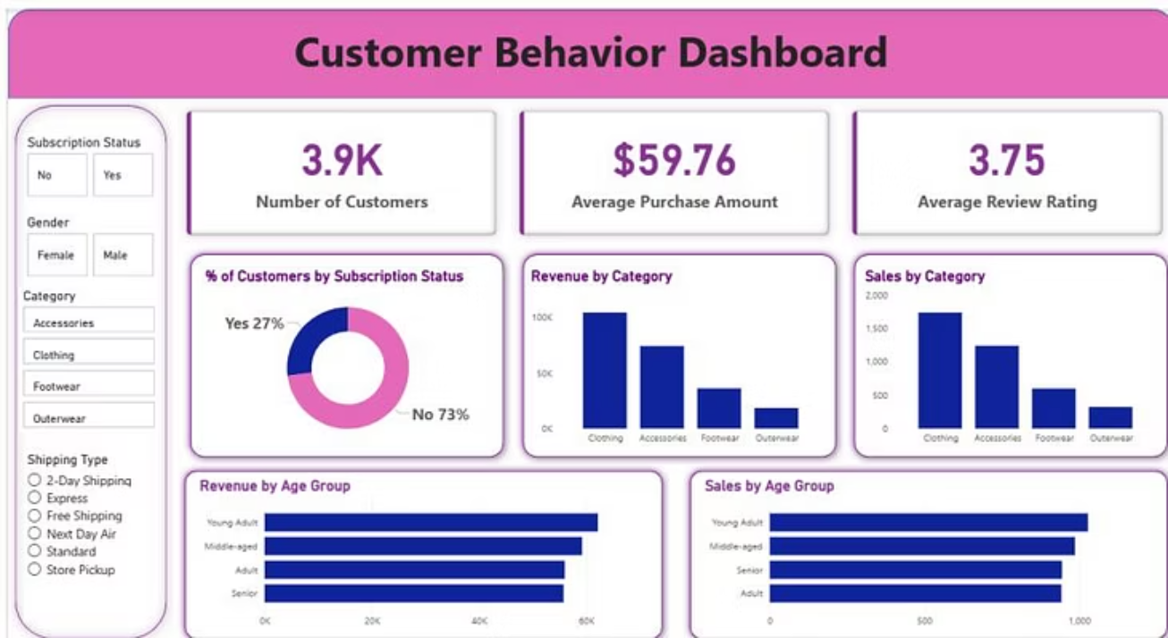
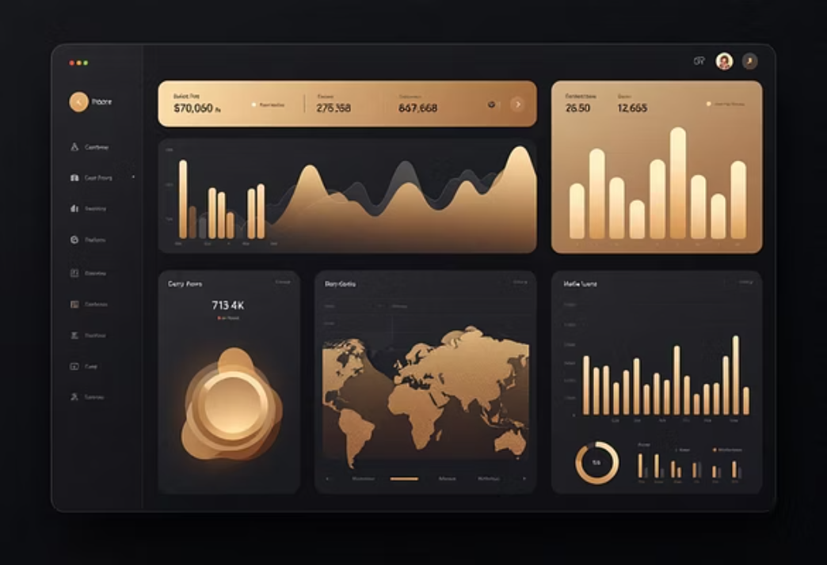
Visualizing Key Metrics
Interactive dashboard built in Power BI for visual presentation.

Slide 9



Dashboard Key Metrics
27%
73%
3.75
Subscribers
Non-Subscribers
Avg. Rating
Percentage of total customers with active subscriptions.
Majority of customers are not currently subscribed.
Overall average review rating across all products.
Revenue is highest in the Clothing category and the Young Adult age group.

Slide 10




Strategic Business Recommendations
Boost Loyalty
Implement loyalty programs to move Returning customers to the Loyal segment.
Promote Subscriptions
Offer exclusive benefits to increase the 27% subscription rate.
Targeted Campaigns
Focus marketing on high-revenue age groups (Young Adult) and Express Shipping users.
Product Positioning
Highlight top-rated products (Gloves, Sandals) in marketing materials.

